Slide 1
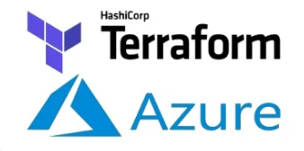
Terraform(IaC) with Azure
2022

Slide 2


What is IaC
What is Terraform
Installation and configuration
Terraform commands

Slide 3
What is IAC? Infrastructure is the collection of hardware and software elements needed to enable cloud computing. It includes computing power, networking, and storage, as well as an interface for users to access their virtualized resources. Infrastructure as Code (IaC) is the managing and provisioning of infrastructure through code instead of through manual processes. With IaC, configuration files are created that contain your infrastructure specifications, which makes it easier to edit and distribute configurations. It also ensures that you provision the same environment every time. By codifying and documenting your configuration specifications, IaC aids configuration management and helps you to avoid undocumented, ad-hoc configuration changes

Slide 4
What is Terraform?
Terraform is HashiCorp's infrastructure as code tool. It lets you define resources and infrastructure in human-readable, declarative configuration files, and manages your infrastructure's lifecycle. Using Terraform has several advantages over manually managing infrastructure:
Terraform is an orchestration tool for provisioning cloud resources
Terraform can manage infrastructure on multiple cloud platforms. e.g. Azure, AWS ,GCP etc.
Terraform uses HashiCorp Configuration Language (HCL)
You can commit your configurations to version control to safely collaborate on infrastructure
Lowers the potential for human errors while deploying and managing infrastructure
Deploys the same template multiple times to create identical development, test, and production environments

Slide 5
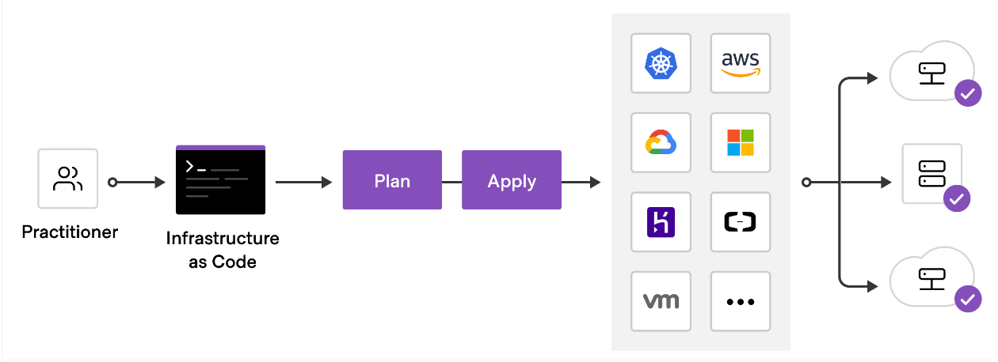

Slide 6
Terraform Use Cases Parallel Environments: Terraform lets you rapidly spin up and decommission infrastructure for development, QA, and production Multi-Cloud Deployment : Provisioning infrastructure across multiple clouds increases fault-tolerance, allowing for more graceful recovery from cloud provider outages https://shadow-soft.com/terraform-config-for-multi-cloud-solution/ https://www.hashicorp.com/products/terraform/multi-cloud-compliance-and-management For more details follow the link below https://www.terraform.io/intro/use-cases

Slide 7
Install Terraform
Two ways to install terraform in windows chocolatey or with executable file
1. Steps to install with chocolatey
Open power shell with admin Install chocolatey for windows https://chocolatey.org/install
choco install terraform ->do you want to run the script by answering y or a
And to check if terraform installed or not open power shell window without admin mode and type terraform -help
Install Azure cli Terraform must authenticate the azure to create infra https://learn.hashicorp.com/tutorials/terraform/azure-build
After azure cli installation put command az login
2. Manual installation by downloading binary and binary should be available on environment variable PATH : https://www.terraform.io/downloads
For more details follow this link https://learn.hashicorp.com/tutorials/terraform/install-cli

Slide 8
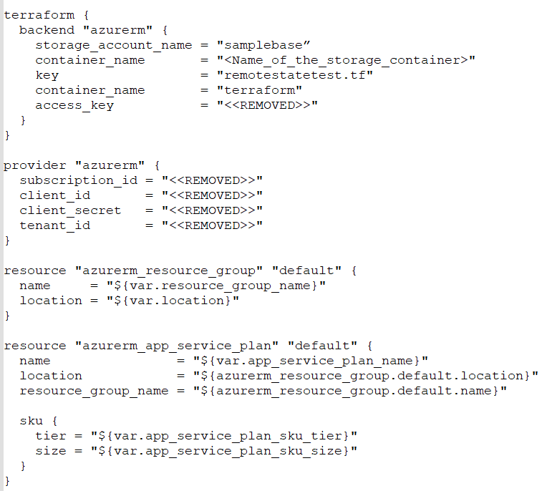
Terraform File Structure
Azurerm Stores the state as a Blob with the given Key within the Blob Container within the Blob Storage Account.
This backend supports state locking and consistency checking with Azure Blob Storage native capabilities

Slide 9
Terraform Variables
Variables can be used throughout the main template
Variables can be set in files (tf) file
Variables can be set in a (tfvar) file
variable "resource_group_name" {
type = string
description = "Name of the azure resource group."
default = "AppResourceGroup"
}
Variables can be set via command line
resource_group_name=TestRG

Slide 10
Terraform Outputs
Outputs can be specified
Outputs can be queried after a run using the terraform output <<output name>>
./terraform output resource_group_id
output "resource_group_id" {
value = azurerm_resource_group.rg.id
}

Slide 11
Terraform Commands
terraform init – initialize state
terraform validate – validate your templates
terraform plan – plan your deployment, see what will occur
terraform apply – execute the deployment
terraform destroy – delete your deployment

Slide 12
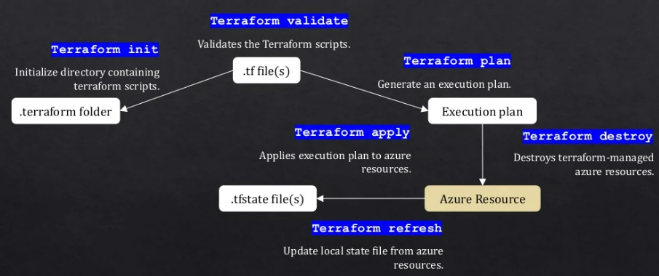

Slide 13
Terraform State
You must initialize the Terraform State
You can also have state per resource group / application. Workspaces should be used to help separate application and environment boundaries.
Remote state should use Azure Blob Storage. Keeping state on a local machine is a big concern. The Pro / Premium Enterprise editions of Terraform provide a state server as well.
You can have people competing over getting a lock to the state file
NOTE: Secrets can be written to your state file
./terraform init

Slide 14
Terraform Plan / Apply
Terraform plan will show you what Terraform will perform
Plans use
+ resource will be created
- resource will be destroyed
~ resource will be updated in place
-/+ resource will be destroyed and re-created
Terraform apply runs the deployment
./terraform plan
./terraform apply

Slide 15
Reference links https://youtu.be/YcJ9IeukJL8 https://www.terraform.io/use-cases/infrastructure-as-code https://learn.hashicorp.com/collections/terraform/azure-get-started https://docs.microsoft.com/en-us/azure/developer/terraform/overview

Slide 16
Thank You!!!

